Slide 1

Ethics, Bias, and Fairness Part II
Rayid Ghani

Slide 2
Reminders
This week:
project check-ins on Wednesday/Thursday
Coming up next week:
Tuesday: update assignment – bias and fairness
Project presentations on Thursday

Slide 3
Plan for the week
What you should be working on with your team this week (and next week)
Finalize model grid/runs
Review entire pipeline – sanity checks and completeness (cohort, labels, features, grid, etc.)
Model fairness metrics and evaluation
Review what’s needed for final presentation and report

Slide 4
Scope
Data
Exploration
Modeling
Get Data
Store Data
Link Data
Rows
Features
Labels
Model Selection
Train-Test Splits
Performance Metrics
Model Interpretation
Entities
temporal
Spatial
…
Models
Dealing with Bias and Fairness
Field Trial Design
Deployment
Monitoring
Goals, Actions, Data, Analysis, Ethics

Slide 5
The focus should not just be on making the ML model fair but rather on making the overall system and outcomes fair
Define (desired fairness or equity goals)
Understand (root causes of bias)
Improve (fairness of AI systems)
Measure and Detect (bias)
Mitigate (the impact through adjusting interventions)
Monitor & Evaluate

Slide 6
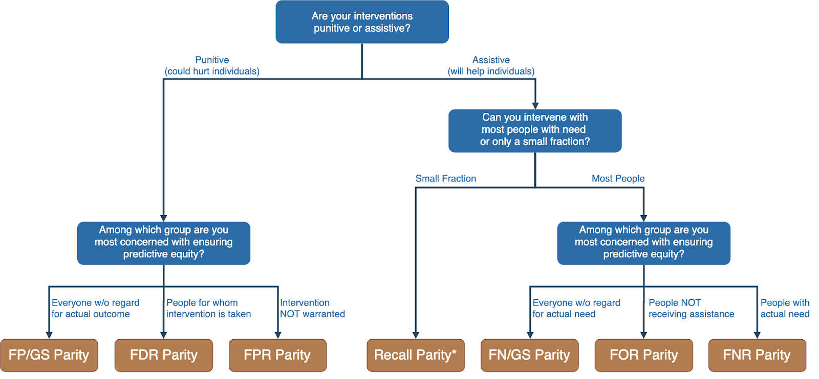
Translating policy goals to fairness metrics

Slide 7
Is the fairness tree “the answer”?

Slide 8
Is the fairness tree “the answer”?
No… but it’s intended as a starting point to help guide a conversation between ML experts, policy makers, and those affected by the decisions.
Ultimately, the choice of fairness metric(s) is highly dependent on context and stakeholder values.

Slide 9
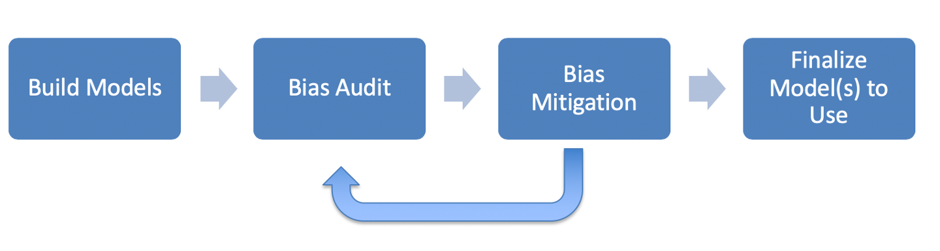
ML Fairness Workflow

Slide 10
How can we reduce bias in ML models?
Fix the world
Pre-Processing: Fix the input data
Remove sensitive attributes (and correlated ones)
Resample and/or reweight protected groups
In-Processing: Optimize for fairness in model training
Post-Processing
Choose fair models during model selection
Post-hoc adjustments to ‘de-bias’ model scores

Slide 11
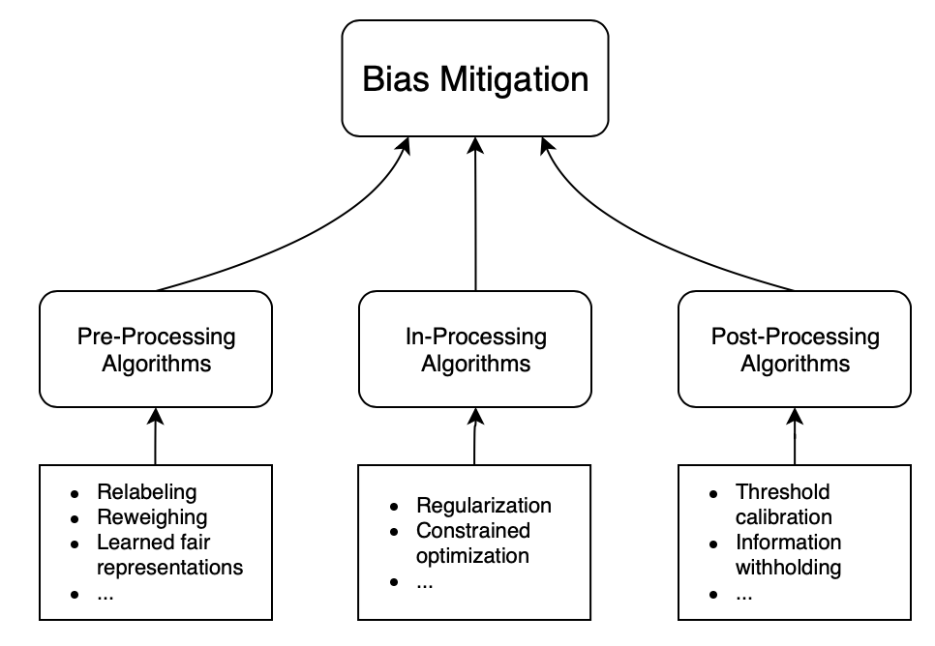
How can we reduce bias in ML models?

Slide 12
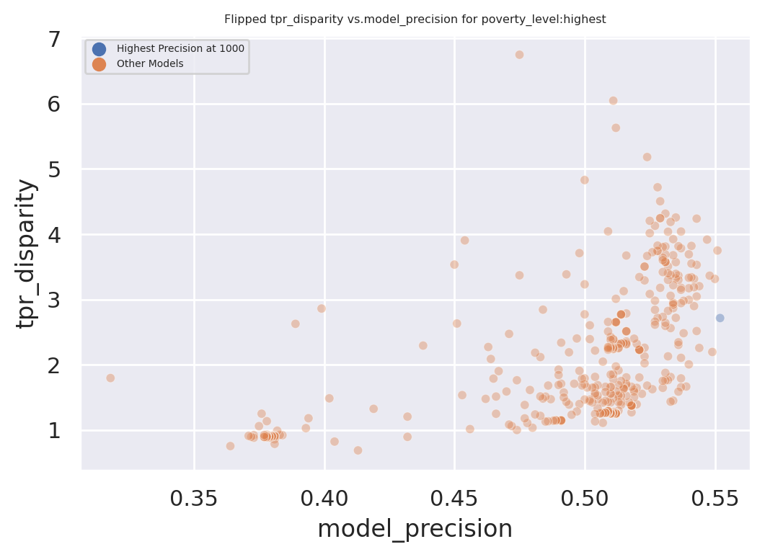
Exploring Trade-Offs
Each point is a different
model specification
Disparity
Precision@k

Slide 13
Exploring Trade-Offs
Each point is a different
model specification
Points further to the right
are more accurate
Disparity
Precision@k

Slide 14
Exploring Trade-Offs
Each point is a different
model specification
Points further to the right
are more accurate
Points closer to 1 on the
y-axis are more fair
Disparity
Precision@k

Slide 15
Exploring Trade-Offs
Disparity
“Best” model just based
on top k precision
Precision@k

Slide 16
Exploring Trade-Offs
Disparity
Pareto Frontier
Precision@k

Slide 17
Exploring Trade-Offs
Disparity
Our hope:
Fairness-improving
methods can expand this
frontier by adding new
points
Precision@k

Slide 18
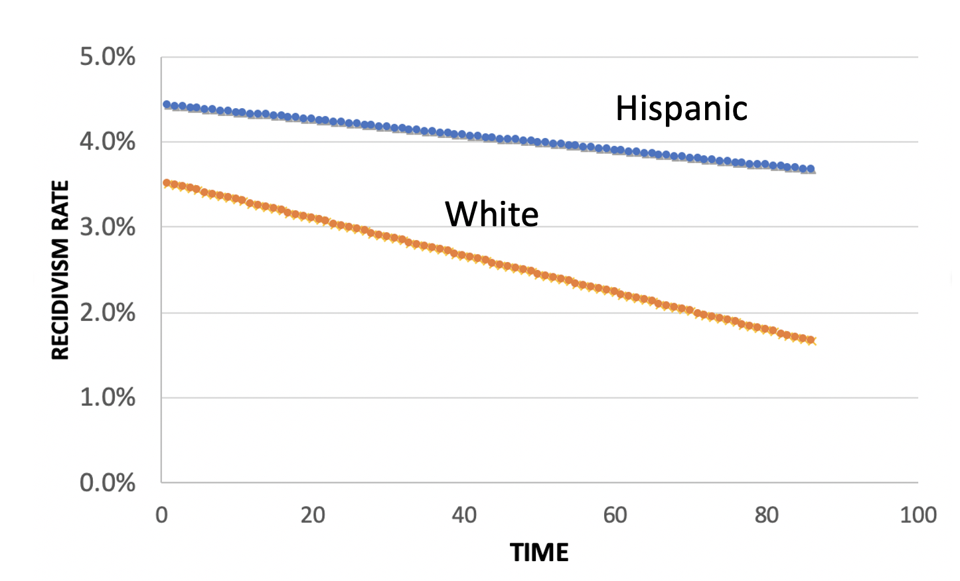
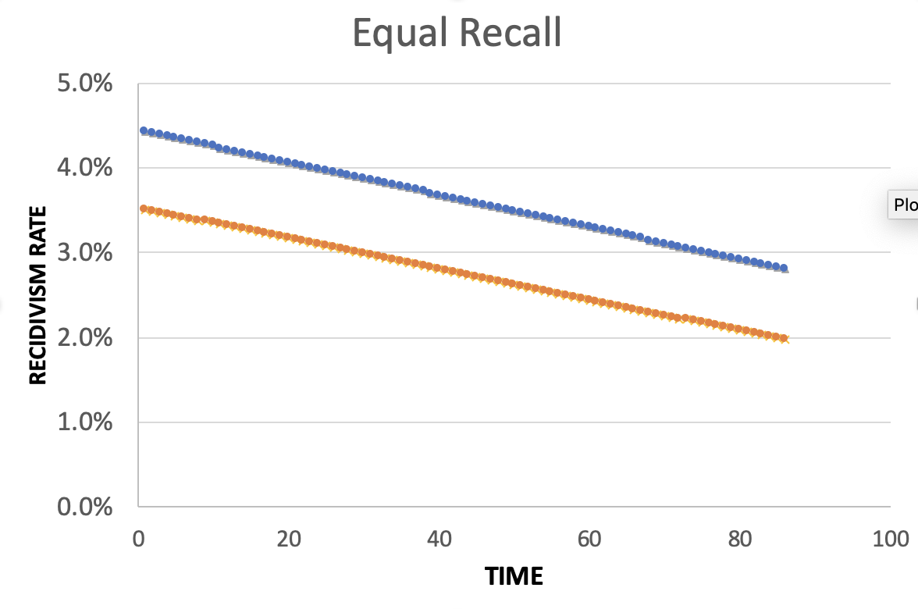
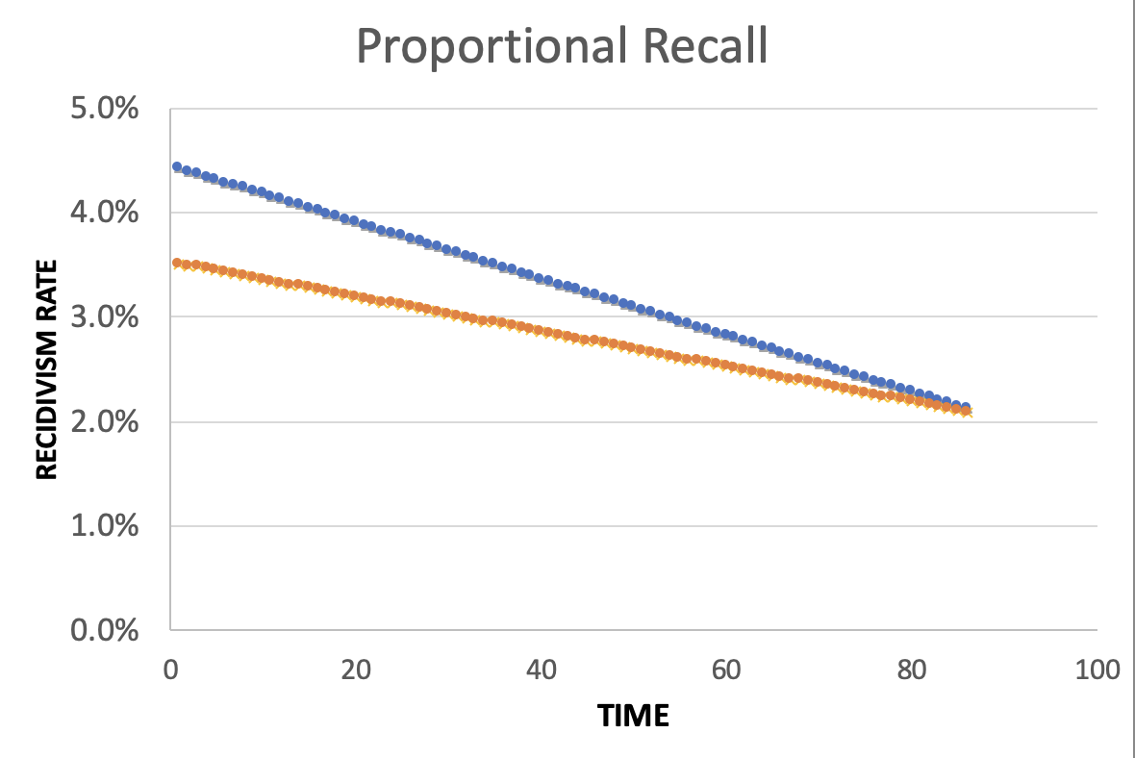
Policy Menu
Designing for Efficiency
72.7% Efficient
Equality
Additional Cost: 2%
Equity
Additional Cost: 2%

Slide 19
Calculating Fairness Metrics for Your Models: aequitas
Triage can calculate various fairness metrics and disparities automatically for you using the aequitas bias audit tool
Specify a bias_audit_config in your triage config
Re-run your models using replace=False
Results can be found in test_results.aequitas

Slide 20
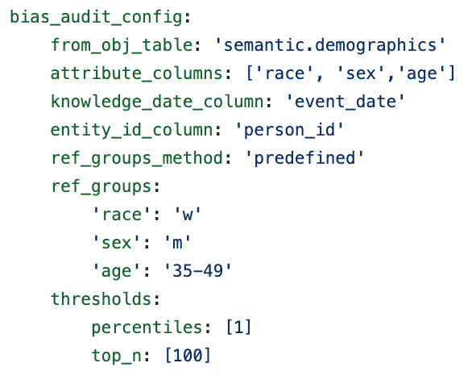
Calculating Fairness Metrics for Your Models: aequitas

Slide 21
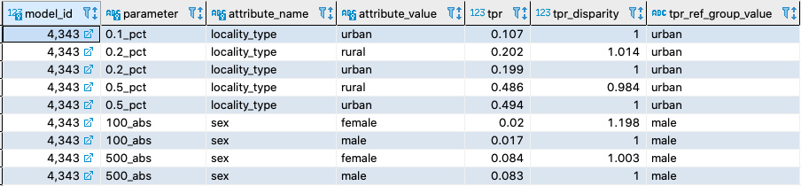
Calculating Fairness Metrics for Your Models: aequitas

Slide 22
Some common practitioner perceptions
There is always a tradeoff between fairness and accuracy
I have to satisfy all measures of bias in order to be fair
I have to eliminate all bias in order to use/deploy an ML system
Not using race in my models makes by models not racist
Using race in my models makes my models racist
A fair ML model = Fair and equitable outcomes
Bias comes from and can be fixed by “fixing” the data
Bias reduction methods actually reduce bias

